Slide 1
Test Design Techniques
Test Design and Black box testing techniques
Week(6-8)

Slide 2
Topics
Identifying test conditions and designing test cases
Categories of test design techniques
Specification-based or black-box techniques
Structure-based or white-box techniques
Experience-based techniques
Choosing a test technique

Slide 3
Test Design Specification, Test Case Specification, and Test Procedure Specification
Test design specification: A document that specifies the test conditions for an item, the test approach, and the high-level test cases.
Test case specification: A document that specifies the test cases, including the inputs, expected results, and execution conditions.
Test procedure specification: A document that specifies the sequence of actions for executing a test.
Notes:
Consider a simple online shopping cart feature. A user can add items to the cart, remove items, and proceed to checkout.
Test Design Specification, Test Case Specification, and Test Procedure Specification
Test Design Specification: This document would outline the overall test approach for the shopping cart feature.
For example, it might specify that we will use equivalence partitioning to test the quantity of items in the cart and boundary value analysis to test price calculations.
It would also include high-level test cases like "Verify that a user can add an item to the cart" or "Verify that a user can remove an item from the cart".
Test Case Specification: This document provides detailed test cases.
For example, a test case for "Add item to cart" would include:
Input: Select an item from the product list.
Expected result: The item is added to the cart with the correct quantity and price.
Another test case for "Remove item from cart" would include:
Input: Remove a specific item from the cart.
Expected result: The item is removed from the cart, and the cart total is updated correctly.
Test Procedure Specification: This document gives step-by-step instructions for executing the test cases.
For the "Add item to cart" test case, the procedure might be:
Navigate to the product page.
Select the item.
Click the "Add to Cart" button.
Verify the cart page is displayed.
Verify the item details in the cart.

Slide 4
Test Condition, Test Case, and Test Procedure
Test condition/scenario: A testable aspect of a component or system.
Test case: A set of input values, execution preconditions, expected results, and execution postconditions developed for a particular objective or test condition.
Test procedure/steps: A sequence of actions for the execution of a test
Notes:
Test Condition, Test Case, and Test Procedure
Test Condition: A testable aspect of the shopping cart feature.
Examples:
Adding an item to the cart.
Removing an item from the cart.
Calculating the total price of items in the cart.
Test Case: A set of inputs, preconditions, expected results, and postconditions for a specific test condition.
Test Case for "Calculate total price":
Input: Add multiple items with different prices to the cart.
Preconditions: The user is on the cart page.
Expected Result: The total price is correctly calculated and displayed.
Postconditions: The user remains on the cart page.
Test Procedure: The sequence of actions to execute the test case.
Test Procedure for "Calculate total price":
Add Item A to the cart.
Add Item B to the cart.
Verify the displayed total price matches the sum of Item A and Item B prices.

Slide 5
Test Procedure Specification Test
Test cases are translated into a test procedure specification.
This is at a level of detail relevant to the knowledge of the testers.
Notes:
Test Procedure Specification
Test cases are translated into test procedure specifications.
This means that the detailed steps needed to execute the test cases are written down.
This is at a level of detail relevant to the knowledge of the testers.
For example, if the testers are familiar with the website's navigation, the procedure might say "Navigate to the cart page". If they are less familiar, it might say "Click on the 'Cart' link in the header".

Slide 6
Test Execution Schedule Test
Test cases are prioritized.
Technical and logical dependencies are considered.

Slide 7
Categories of Test Design Techniques
Specification-based (black-box)
Structure-based (white-box)
Experience-based

Slide 8
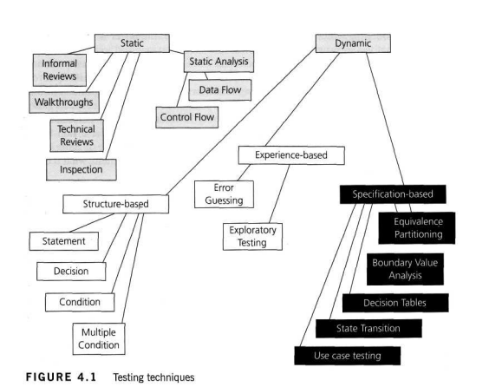
Testing Techniques

Slide 9
Black Box Testing techniques
Specification-based (Black-box) Techniques Equivalence partitioning:
Divides input data into valid and invalid partitions.
Selects representative values from each partition as test data.
Aims to reduce the number of test cases while maintaining coverage.
Example: For an age field that accepts values from 18 to 65, we can create three partitions: valid (18-65), invalid below (less than 18), and invalid above (greater than 65). Test cases would include values like 17, 30, and 70.
Boundary value analysis:
Tests the boundary values of input partitions.
Focuses on the minimum, maximum, and near-boundary values.
Effective in finding errors at the edges of input ranges.
Example: Using the same age field, boundary values would be 18, 19, 64, 65, 17, and 66.

Slide 10
Black Box Testing techniques
Decision table testing:
Creates tables to represent complex logic and conditions.
Each column in the table represents a unique test case.
Ensures all possible combinations of conditions are tested.
Example: For a loan approval system with conditions like income, credit score, and employment status, a decision table would specify test cases for each combination of these conditions (e.g., high income, good credit, employed = approved).
State transition testing:
Tests system behavior based on different states and transitions.
Uses state diagrams to model system behavior.
Verifies that the system moves correctly between states.
Example: Testing an online order system where states might be "pending," "paid," "shipped," and "delivered." Test cases would cover transitions between these states.

Slide 11
Black Box testing techniques
Use case testing:
Tests system functionality from the user's perspective.
Creates test cases based on use case scenarios.
Validates end-to-end workflows and interactions.
Example: Testing the "place an order" use case, including steps like browsing products, adding to cart, providing payment information, and confirming the order.

